Slide 1
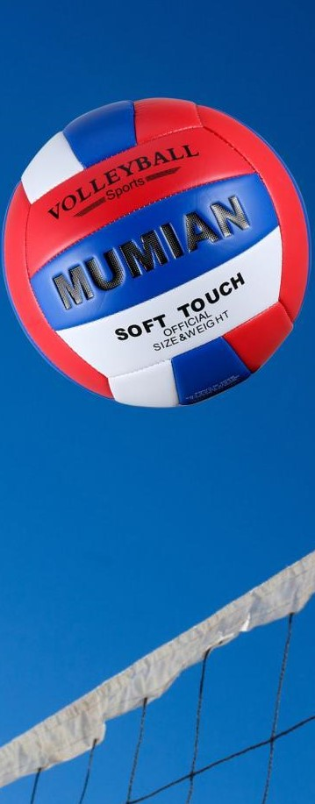
Westside High School
Jan 16-20th Week At a Glance (WAG)

Slide 2
Coach Thomas
Rec. Games: Jan 16-20

Slide 3
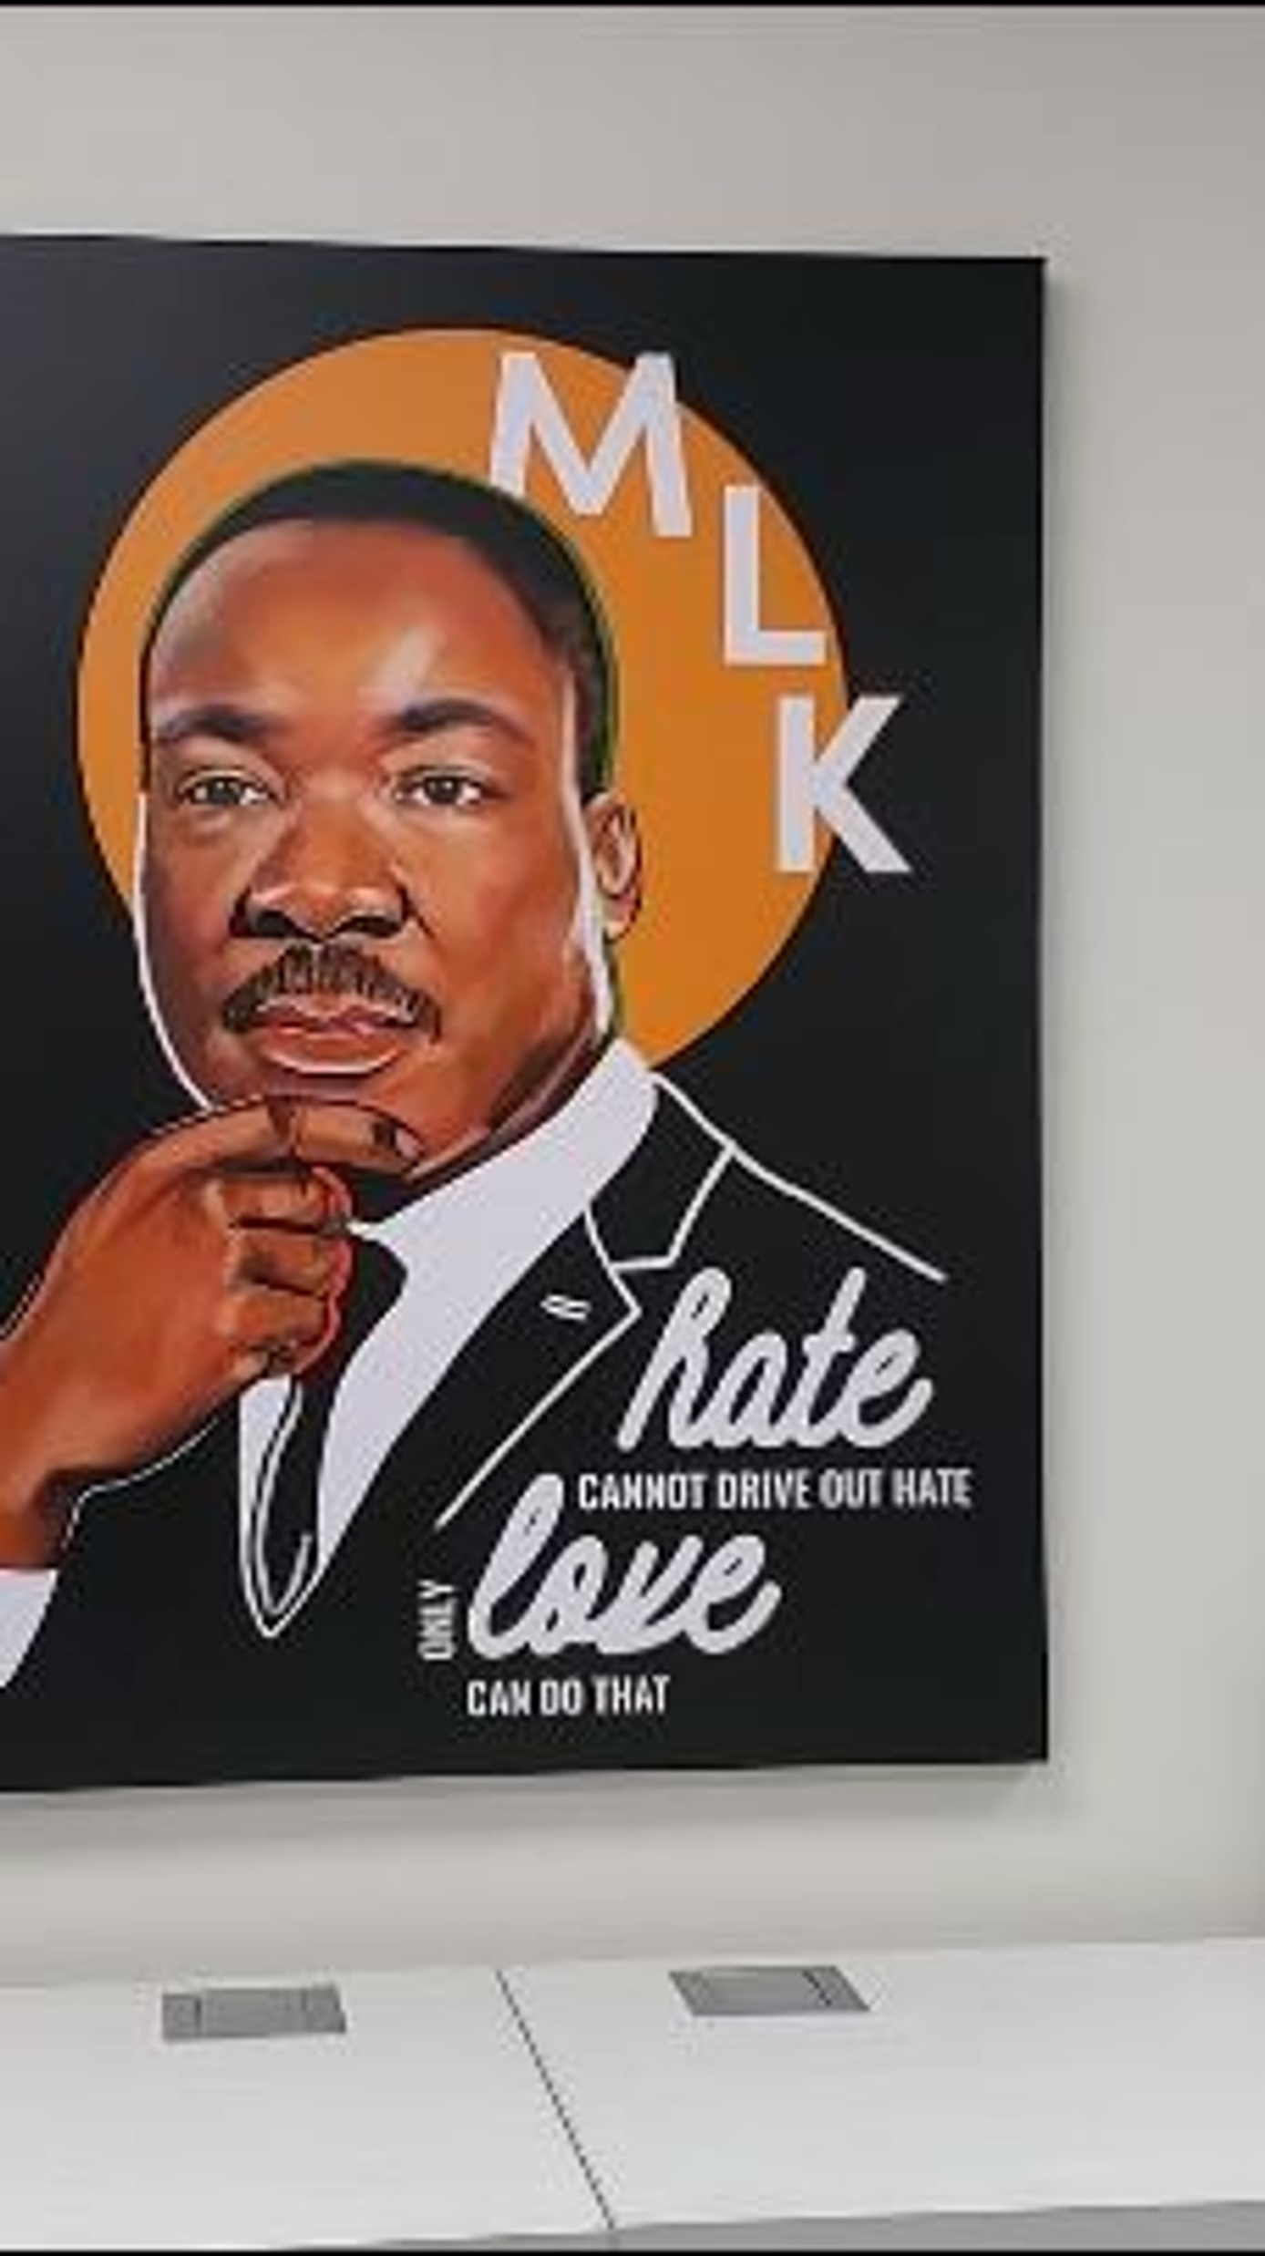
Monday - Agenda
Learning Target
Opening ( 10-15 mins)
Jan 16th
Standard: N/A
Work-session ( 20 - 25 mins)
Criteria for Success
Closing ( 05 – 10 mins)

Slide 4
Tuesday - Agenda
Learning Target
Jan. 17th Standard:
PERG.1 The physically educated student demonstrates competency in a variety of motor skills and movement patterns.
a. Demonstrates competence while performing skills in a variety of recreational game settings and activities
b. Performs skills at a level of competence, which contributes to health-related fitness.
c. Demonstrates proper warm-up and cool-down protocol associated with different life time
sport physical activities.
PERG. 2 The physically educated student applies the knowledge of concepts, principles, strategies, and tactics related to movement and performance.
Integrates a variety of strategies, tactics, concepts, and skills during recreational games activities
Evaluates skills needed for recreational games and leisure activities
PERG.3 The physically educated student demonstrates knowledge and skills to help achieve
and maintain a health-enhancing level of physical activity and fitness.
a. Maintains or improves fitness level by using the results of the Georgia Fitness Assessment
to guide changes in a personal program of physical activity.
b. Uses technologies to assess, enhance, and maintain health-related and skill-related fitness.
c. Analyzes the relationship between physical activity and longevity.
Personal and Social Behavior, Rules, Safety, and Etiquette
I can use the proper techniques to do the following volleyball hit: bump & set
Opening ( 10-15 mins)
5-10 minute static & dynamic stretches (5 minutes locker rooms)
Work-session ( 20 - 25 mins)
Teacher will review from previous week’s activities
Students will be called down to continue to complete volleyball hits assessment (bump & set)
If time permits students can free play
Criteria for Success
Students are able to use techniques and skills learned during previous week for volleyball assessment
Closing ( 05 – 10 mins)
locker room unlocked for 5 minutes
-students use remaining time to cool down & rehydrate if necessary

Slide 5
Wednesday - Agenda
Learning Target
Jan 18th Standard:
PERG.1 The physically educated student demonstrates competency in a variety of motor skills and movement patterns.
a. Demonstrates competence while performing skills in a variety of recreational game settings and activities
b. Performs skills at a level of competence, which contributes to health-related fitness.
c. Demonstrates proper warm-up and cool-down protocol associated with different life time
sport physical activities.
PERG. 2 The physically educated student applies the knowledge of concepts, principles, strategies, and tactics related to movement and performance.
Integrates a variety of strategies, tactics, concepts, and skills during recreational games activities
Evaluates skills needed for recreational games and leisure activities
PERG.3 The physically educated student demonstrates knowledge and skills to help achieve
and maintain a health-enhancing level of physical activity and fitness.
a. Maintains or improves fitness level by using the results of the Georgia Fitness Assessment
to guide changes in a personal program of physical activity.
b. Uses technologies to assess, enhance, and maintain health-related and skill-related fitness.
c. Analyzes the relationship between physical activity and longevity.
Personal and Social Behavior, Rules, Safety, and Etiquette
1. I can demonstrate my understanding of the proper technique for serving the volleyball (underhand and/or overhand)
Opening ( 10-15 mins)
10 minute Walk & Attendance
Work-session ( 20 - 25 mins)
Students will be cold called to complete volleyball serving assessment
Student will play best 2 of 3 (going to 15)
Criteria for Success
Closing ( 05 – 10 mins)
Same as previous day.
-locker room unlocked for 5 minutes
-students use remaining time to cool down & rehydrate if necessary

Slide 6
Thursday - Agenda
Learning Target
Same as Tuesday & Wednesday
Jan 19th Standard:
PERG.1 The physically educated student demonstrates competency in a variety of motor skills and movement patterns.
a. Demonstrates competence while performing skills in a variety of recreational game settings and activities
b. Performs skills at a level of competence, which contributes to health-related fitness.
c. Demonstrates proper warm-up and cool-down protocol associated with different life time
sport physical activities.
PERG. 2 The physically educated student applies the knowledge of concepts, principles, strategies, and tactics related to movement and performance.
Integrates a variety of strategies, tactics, concepts, and skills during recreational games activities
Evaluates skills needed for recreational games and leisure activities
PERG.3 The physically educated student demonstrates knowledge and skills to help achieve
and maintain a health-enhancing level of physical activity and fitness.
a. Maintains or improves fitness level by using the results of the Georgia Fitness Assessment
to guide changes in a personal program of physical activity.
b. Uses technologies to assess, enhance, and maintain health-related and skill-related fitness.
c. Analyzes the relationship between physical activity and longevity.
Personal and Social Behavior, Rules, Safety, and Etiquette
Opening ( 10-15 mins)
5 minute Walk & Attendance
Work-session ( 20 - 25 mins)
Make up day for volleyball assessments
Parent contact for those that possibly choose not to do the assessment
Criteria for Success
Closing ( 05 – 10 mins)
Same as previous day
-locker room unlocked for 5 minutes
-students use remaining time to cool down & rehydrate if necessary

Slide 7
Friday - Agenda
Learning Target
Jan. 20th Standard:
PERG.1 The physically educated student demonstrates competency in a variety of motor skills and movement patterns.
a. Demonstrates competence while performing skills in a variety of recreational game settings and activities
b. Performs skills at a level of competence, which contributes to health-related fitness.
c. Demonstrates proper warm-up and cool-down protocol associated with different life time
sport physical activities.
PERG.3 The physically educated student demonstrates knowledge and skills to help achieve
and maintain a health-enhancing level of physical activity and fitness.
a. Maintains or improves fitness level by using the results of the Georgia Fitness Assessment
to guide changes in a personal program of physical activity.
b. Uses technologies to assess, enhance, and maintain health-related and skill-related fitness.
c. Analyzes the relationship between physical activity and longevity.
Personal and Social Behavior, Rules, Safety, and Etiquette
Freestyle Friday
Opening ( 10-15 mins)
Attendance
Work-session ( 20 - 25 mins)
Students are able to engage in various activities/sports typically those that they are most interested
Teacher will conference will students and possibly make parent phone calls/contact as needed
Criteria for Success
I can demonstrate my understanding of the rules, procedures, and expectations by following them during class time and asking questions to teacher if necessary.
Closing ( 05 – 10 mins)
N/A

Slide 8
Resources
https://www.youtube.com/watch?v=az_oouQa6VY

